Slide 1
WAPT Week 2 Practical Activity 2.2.7
Rifa Ilyasa Achrinza
Tan Jia shun (Alan)
Lim Jun Hao

Slide 2
Wayback machine
Wayback Machine is a tools that allow user to view a snapshot of website
Allow us to view the past website post and design
We can use Wayback Machine as web crawler
Find interesting path without getting known
May be able to find vulnerabilities too

Slide 3
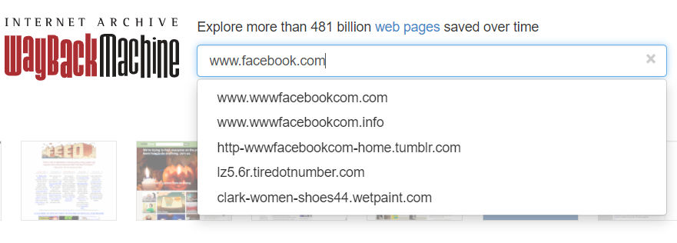
How to Wayback machine
Step 1: go to http://web.archive.org/
Step 2: enter a website and press enter key

Slide 4

How to Wayback machine
Step 3: click on collection button
Step 4: look for any file with .zip .backup .config .csv /api//admin/

